Slide 1

Database Management System (CS232) BS(SE,CySec) gg
Week 06
Said Nabi
said.nabi@giki.edu.pk
Faculty of Computer Science and engineering
Gik Institute Topi, Swabi

Slide 2
Enhanced ERD
Introduction to the EER Model
Concept of Superclass and Subclass
Inheritance, Specialization, and Generalization
UNION Types (Categories) in EER
Mapping from ERD, EER to Tables

Slide 3
The Need for EER
ER Model has limitations when dealing with hierarchical data
Complex applications require more abstraction
Helps in better database design by modeling:Real-world hierarchical relationships
Advanced constraints
Example Use Cases: University Database: Students, Professors, and Departments Banking System: Customers, Employees, and Accounts
Scooter
Truck
Car
Color
Year
Year
Brand
Color
Brand

Slide 4
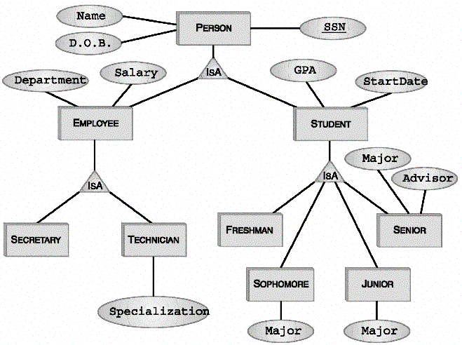
What is the EER Model?
Enhanced ERD
An extension of the ER model with additional concepts
Introduced to handle complex real-world applications
Enhances standard ER models by incorporating:
Subclasses & Superclasses
Specialization & Generalization
Inheritance
Categories (Union Types)

Slide 5
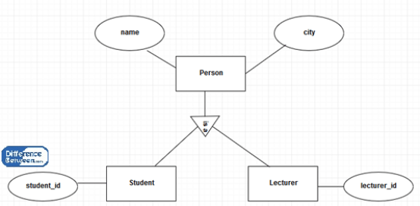
ER vs. EER
Feature | ER Model | EER Model
Entities & Relationships | ✅ Yes | ✅ Yes
Attributes | ✅ Yes | ✅ Yes
Subclasses & Superclasses | ❌ No | ✅ Yes
Specialization & Generalization | ❌ No | ✅ Yes
Inheritance | ❌ No | ✅ Yes
Categories (Union Types) | ❌ No | ✅ Yes

Slide 6
Components of the EER Model
Entities and Relationships
Attributes and Keys
Subclasses & Superclasses
Specialization & Generalization
Inheritance
Categories (Union Types)

Slide 7
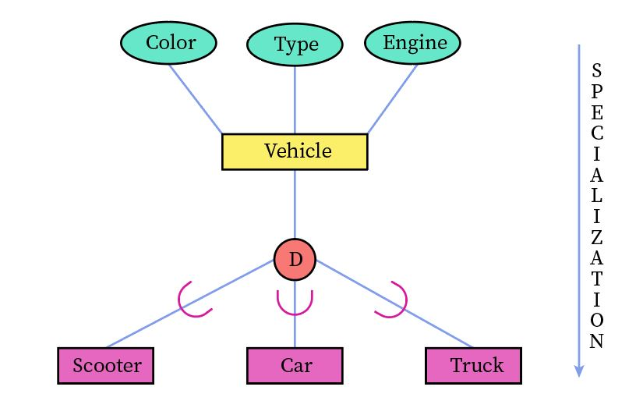
Components of the EER Model Cont..
Superclass
Subclasses

Slide 8
Specialization & Generalization
One Way
Tax_ID
Address
Phone
NIC
Customer_ID
Customer
Profession
Registration_ID
Contact Person
Designation
Indvidual
Organization

Slide 9
Specialization & Generalization
2nd Way
Phone
Address
Customer_ID
Customer
d
Registration_ID
Organization
NIC
Individual
Profession
Designation
Contact Person
Tax_ID

Slide 10
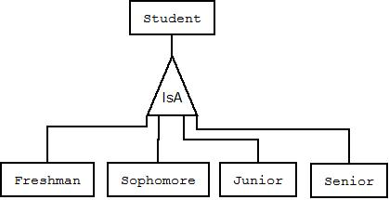
Inheritance (Subclasses VS Super classes
Inheritance is a relationship where a subclass (or child entity) derives its attributes and relationships from a superclass (or parent entity). This is similar to the “is-a” relationship.
It shows that every instance of a subclass is also an instance of the superclass. For example, if an Employee is a subclass of Person, every employee is a person and thus has all the attributes that a person possesses.

Slide 11
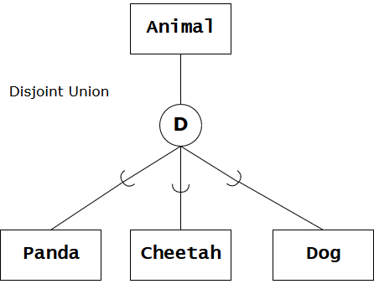
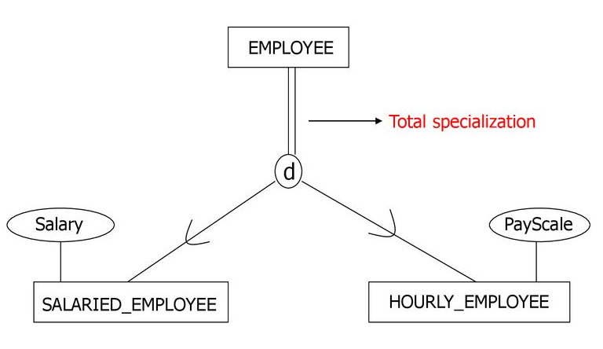
Total vs. Partial Specialization
Total Specialization: Every entity in the superclass must belong to at least one subclass.
Notation often uses a double line from the superclass to the specialization circle.
Partial Specialization: Some entities in the superclass may not belong to any subclass.
Notation often uses a single line from the superclass to the specialization circle.

Slide 12
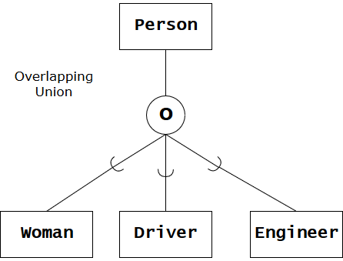
Disjoint VS Overlapping Constraints
Disjoint Constraint: An entity can belong to only one of the subclasses.
Example: A Vehicle can be either a Car or a Motorcycle, but not both.
Overlapping Constraint: An entity can belong to multiple subclasses.
Example: An Employee might be both a Manager and a Mentor at the same time.

Slide 13
Aggregation vs. Association
Aggregation is a higher-level abstraction where a relationship (or multiple relationships) is treated as a separate, composite entity. This is particularly useful when you want to encapsulate a complex interaction among several entities into a single conceptual unit.
It groups together related entities or relationships that together form a higher-level entity.
The aggregated relationship may have its own attributes or identity

Slide 14
Example. 1
Offerings
Department
Offers
Courses
Enquire
Student

Slide 15
Example. 2
Treatment
Doctor
Dignosis
Patient
Filling
P_History
Notes:
aggregation means grouping a relationship and its connected entities into one “bigger” entity

Slide 16
Case Study
A university wants to design a database system to manage its students and faculty members efficiently. The university has different categories of students, including Undergraduate Students and Graduate Students. Each student has a unique ID, name, and date of birth. Graduate students work on a thesis and have an assigned advisor, whereas undergraduate students have a major and may also have a minor.
Similarly, faculty members are categorized into Professors and Lecturers. All faculty members have a unique ID, name, and department. Professors have research specializations, while lecturers are primarily responsible for teaching.
Based on this scenario, identify the superclasses and subclasses, and suggest a suitable Enhanced Entity-Relationship (EER) model with appropriate attributes.

Slide 17
Desiging EER
Identifying all superclasses and their attributes
Identifying all subclasses and their attributes
Representing the EER Model – Disjoint rule, overlapping rule, Total specilaization rule, partial specilaization rule

Slide 18
Identifying Superclasses
From the scenario, we can identify two main superclasses:
Student (Superclass) - Represents all students.
FacultyMember (Superclass) - Represents all faculty members.
Step 2: Identifying Subclasses
Each superclass has specialized entities, which can be modelled as subclasses:
Student (Superclass)
UndergraduateStudent (Subclass) → Has attributes: Major, Minor
GraduateStudent (Subclass) → Has attributes: ThesisTitle, Advisor
FacultyMember (Superclass)
Professor (Subclass) → Has attribute: ResearchSpecialization
Lecturer (Subclass) → Has attribute: CoursesTaught

Slide 19
EER for Uinversity
Name
Name
StudentID
FacultyID
Student
Faculty
DOB
DEPT
d
d
Undergrade
Grade
Lecturer
Prof
Major
Minor
CoursesTaught
Advisor
Research. A
Th.T

Slide 20
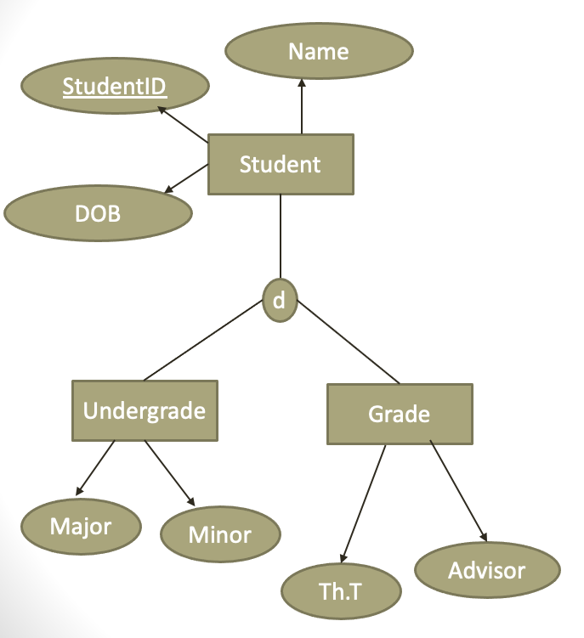
Subclass Discriminator
A subclass discriminator is an attribute in the superclass that determines to which subclass an entity belongs. It is particularly useful in disjoint specialization, where an entity can only belong to one subclass at a time.
Student Type

Slide 21
Mapping ERD to Tables
ER-to-Relational Mapping Algorithm
Step 1: Mapping of Regular Entity Types
Step 2: Mapping of Weak Entity Types
Step 3: Mapping of Binary 1:1 Relation Types
Step 4: Mapping of Binary 1:N Relationship Types.
Step 5: Mapping of Binary M:N Relationship Types.
Step 6: Mapping of Multivalued attributes.
Step 7: Mapping of N-ary Relationship Types.
Mapping of Recursive Relationship Types.
Mapping EER Model Constructs to Relations
Step 8: Options for Mapping Specialization or Generalization.
Step 9: Mapping of Union Types (Categories).

Slide 22
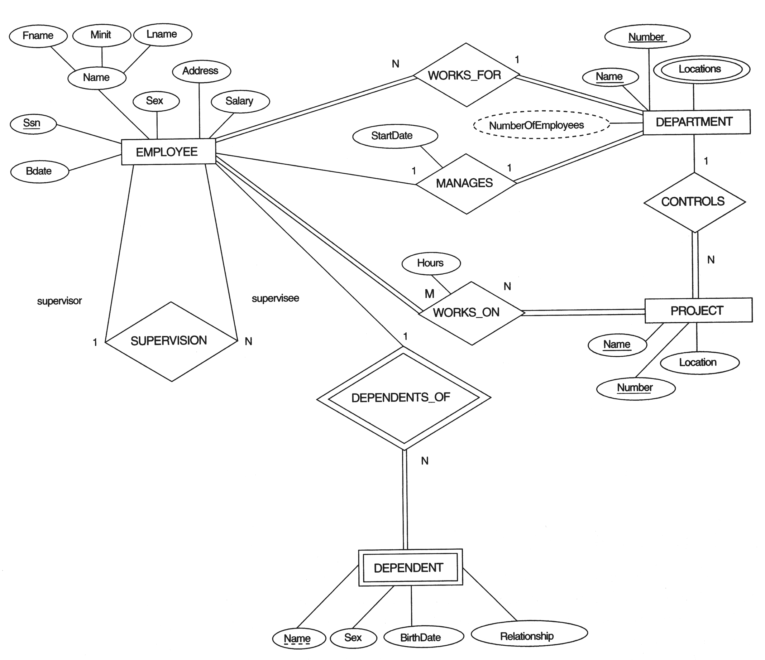
FIGURE 7.1 The ER conceptual schema diagram for the COMPANY database.

Slide 23
Mapping ERD to Tables
Step 1: Mapping of Regular Entity Types.
For each regular (strong) entity type E in the ER schema, create a relation R that includes all the simple attributes of E.
Choose one of the key attributes of E as the primary key for R.
If the chosen key of E is composite, the set of simple attributes that form it will together form the primary key of R.
Example: We create the relations EMPLOYEE, DEPARTMENT, and PROJECT in the relational schema corresponding to the regular entities in the ER diagram.
SSN, DNUMBER, and PNUMBER are the primary keys for the relations EMPLOYEE, DEPARTMENT, and PROJECT as shown.

Slide 24
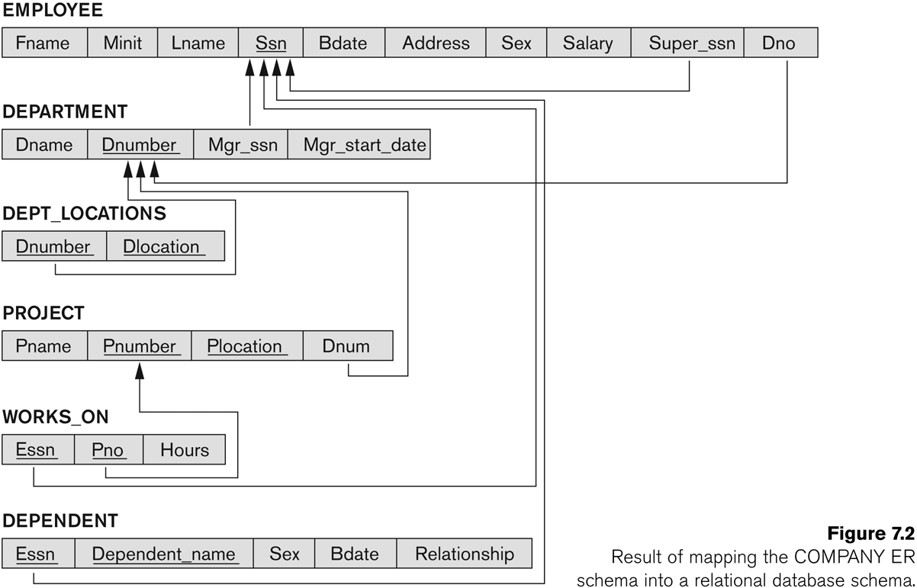
FIGURE 7.2 Result of mapping the COMPANY ER schema into a relational schema.

Slide 25
ER-to-Relational Mapping Algorithm (contd.)
Step 2: Mapping of Weak Entity Types
For each weak entity W with an owner entity E, create a relation R and include all simple attributes of W.
Add the primary key of E as a foreign key in R.
The primary key of R is the combination of the owner's primary key and W's partial key (if applicable).
Example:
Create the DEPENDENT relation to represent the weak entity DEPENDENT.
Add ESSN (renamed from SSN) as a foreign key, referencing the EMPLOYEE relation.
Define the primary key as {ESSN, DEPENDENT_NAME}, since DEPENDENT_NAME is the partial key.

Slide 26
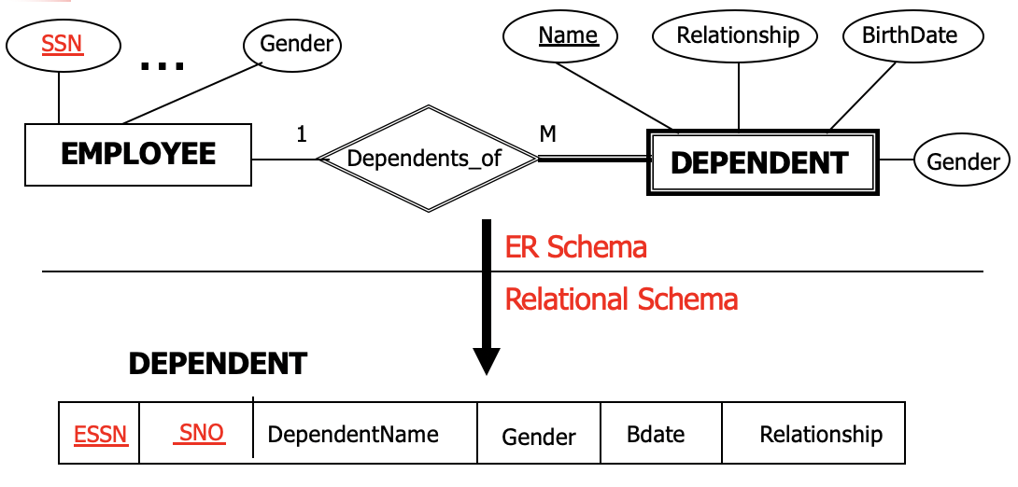
ER-to-Relational Mapping Algorithm (contd.)
Step 2: Mapping of Weak Entity Types

Slide 27
ER-to-Relational Mapping Algorithm (contd.)
Step 3: Mapping of Binary 1:1 Relation Types
For each binary 1:1 relationship type R in the ER schema, identify the relations S and T that correspond to the entity types participating in R.
Three Possible Approaches:
Foreign Key Approach: Add the primary key of entity T as a foreign key in S, preferably when S has total participation in the relationship.
Merged Relation Approach: Combine both entity types and their relationship into a single relation, suitable when both entities have total participation.
Cross-Reference Approach: Create a third relation R to cross-reference the primary keys of S and T, effectively representing the relationship

Slide 28
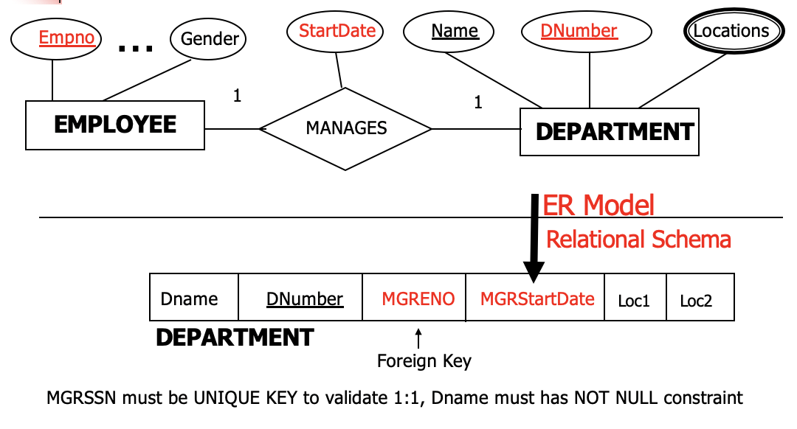
ER-to-Relational Mapping Algorithm (contd.)
Mapping of Binary 1:1 Relation Types using Foreign Key approach

Slide 29
ER-to-Relational Mapping Algorithm (contd.)
Step 4: Mapping Binary 1:N Relationship Types
Identify relation S at the N-side of the 1:N relationship R and T at the 1 side.
Add the primary key of relation T as a foreign key in S.
Include any simple attributes of R as attributes in S.
Example:
In WORKS_FOR, the DNUMBER (primary key of DEPARTMENT) is added as DNO (foreign key) in EMPLOYEE.
Similar mappings apply for CONTROLS and SUPERVISION.

Slide 30
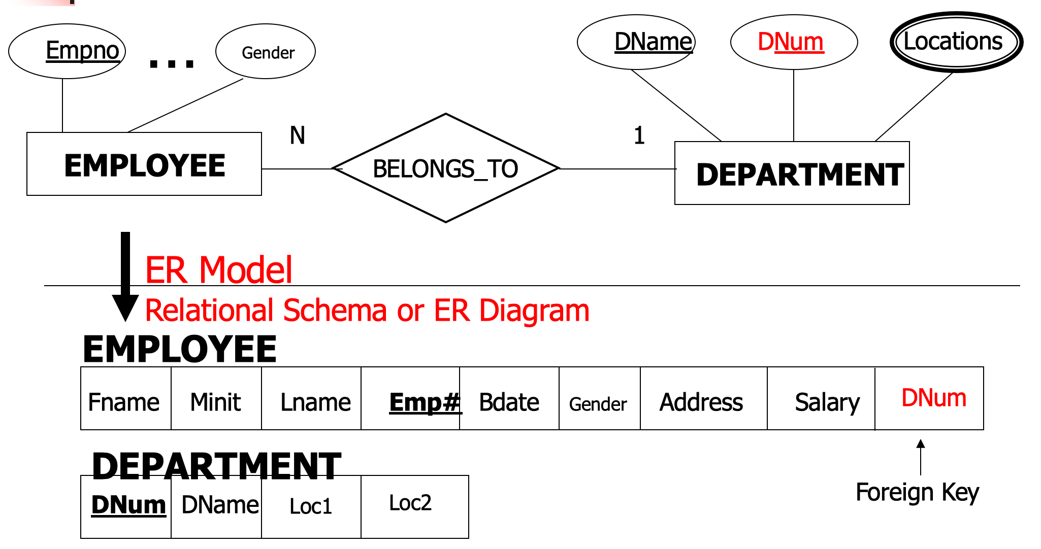
ER-to-Relational Mapping Algorithm (contd.)
Step 4: Mapping of Binary 1:N Relationship Types: Another Example

Slide 31
ER-to-Relational Mapping Algorithm (contd.)
Step 5: Mapping Binary M:N Relationship Types
Create a new relation S to represent the M:N relationship R.
Include primary keys of participating entities as foreign keys in S, forming its composite primary key.
Add simple attributes of R as attributes in S.
Example:
The WORKS_ON relationship is mapped into a WORKS_ON relation in the database.
Primary keys of PROJECT (PNO) and EMPLOYEE (ESSN) are added as foreign keys in WORKS_ON.
HOURS attribute is stored in WORKS_ON.
The primary key of WORKS_ON is (ESSN, PNO).

Slide 32
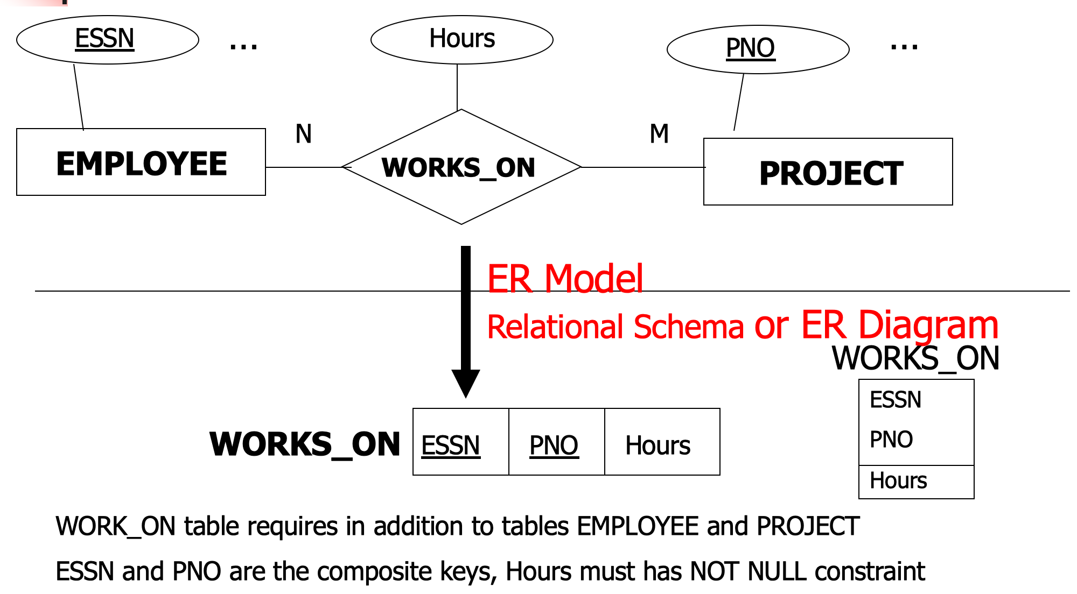
ER-to-Relational Mapping Algorithm (contd.)
Step 5: Mapping of Binary M:N Relationship Types.

Slide 33
ER-to-Relational Mapping Algorithm (contd.)
Step 6: Mapping Multivalued Attributes
For each multivalued attribute A, create a new relation R.
R includes:
A as an attribute.
K (Primary key of the related entity) as a foreign key.
The primary key of R is the combination of A and K.
If A is composite, include its simple components.
Example:
DEPT_LOCATIONS is created to store the LOCATIONS of a DEPARTMENT.
DLOCATION represents the multivalued attribute.
DNUMBER (foreign key) links to DEPARTMENT.
Primary key of DEPT_LOCATIONS = {DNUMBER, DLOCATION}.

Slide 34
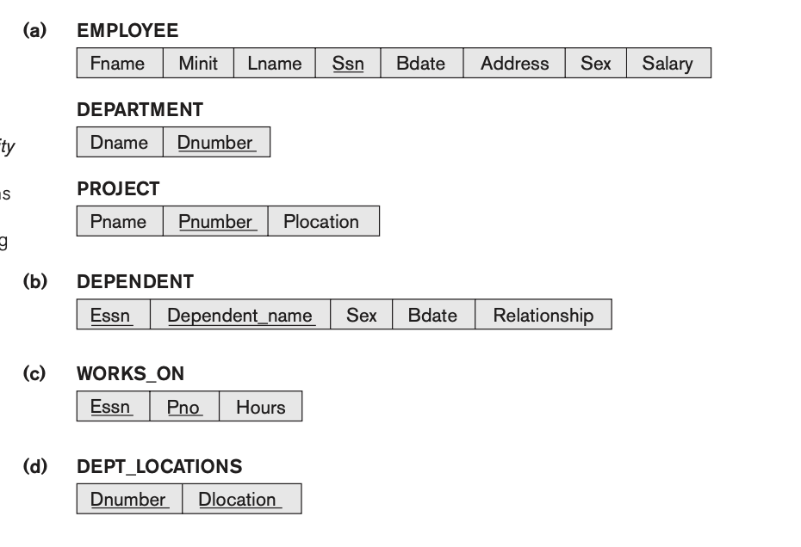
ER-to-Relational Mapping Algorithm (contd.)
Step 6: Mapping of Multivalued attributes.

Slide 35
ER-to-Relational Mapping Algorithm (contd.)
Step 7: Mapping N-ary Relationship Types
For each n-ary relationship (n > 2), create a new relation S.
Include foreign keys for the primary keys of participating entities.
Add simple attributes (or components of composite attributes) of R to S.
Example:
The SUPPY relationship is mapped to the SUPPLY relation.
Foreign keys: SNAME, PARTNO, PROJNAME (Primary key = combination of these foreign keys).

Slide 36
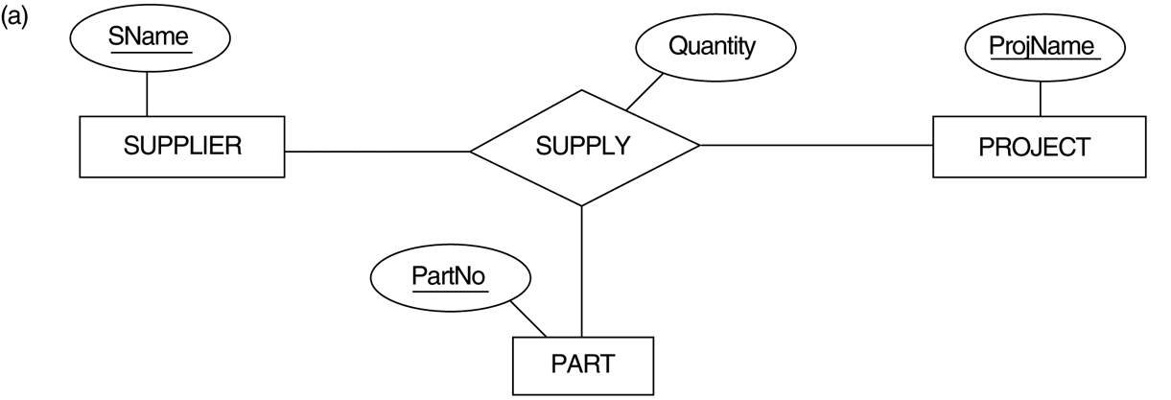
FIGURE 4.11 Ternary relationship types. (a) The SUPPLY relationship.

Slide 37
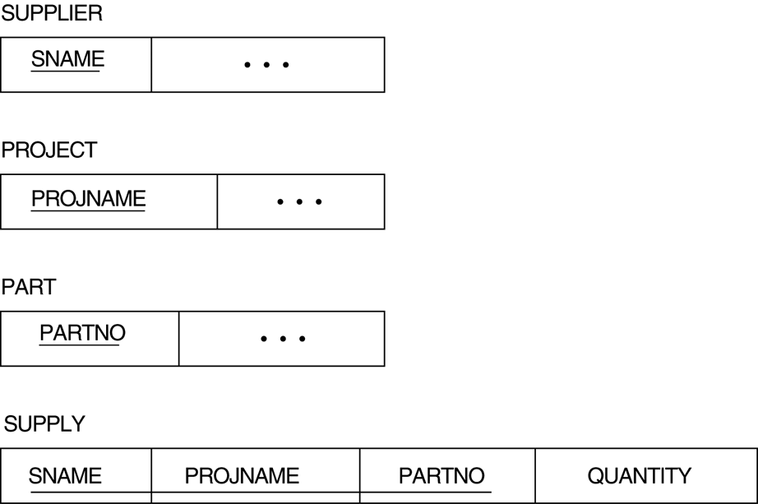
FIGURE 7.3 Mapping the n-ary relationship type SUPPLY from Figure 4.11a.

Slide 38
Mapping of Recursive Relationship Types
SSN
Name
Gender
N
EMPLOYEE
Supervisor
Manages

Slide 39
Mapping of Recursive Relationship Types
SSN
Name
Gender
N
EMPLOYEE
Supervisor
Manages
1
ER Model
Relational Schema or ER Diagram
Fname
Minit
Lname
SSN
Bdate
Gender
Address
Salary
MGRSSN
EMPLOYEE
Foreign Key

Slide 40
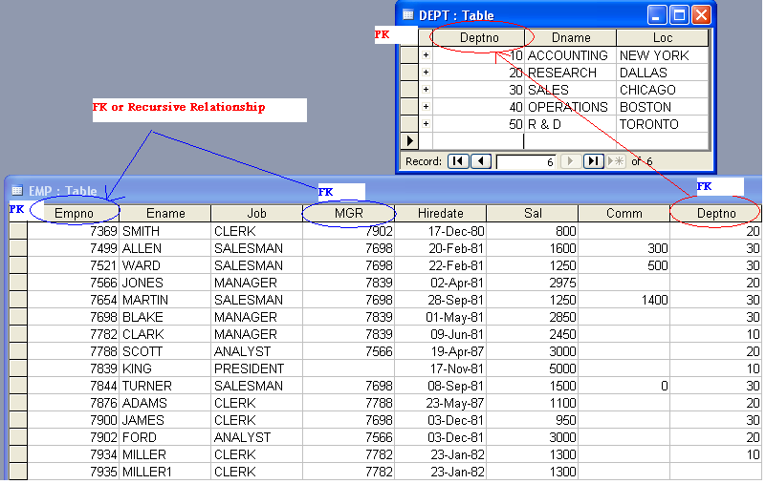
Example: Recursive Relationship

Slide 41
Summary of Mapping constructs and constraints
Table 7.1 Correspondence between ER and Relational Models
ER Model Relational Model
Entity type “Entity” relation
1:1 or 1:N relationship type Foreign key
M:N relationship type relation and two foreign keys
n-ary relationship type relation and n foreign keys
Simple attribute Attribute
Composite attribute Set of simple component attributes
Multivalued attribute Relation and foreign key
Value set Domain
Key attribute Primary (or secondary) key

Slide 42

Any Questions??

